Slide 1

Polymorphism

Slide 2
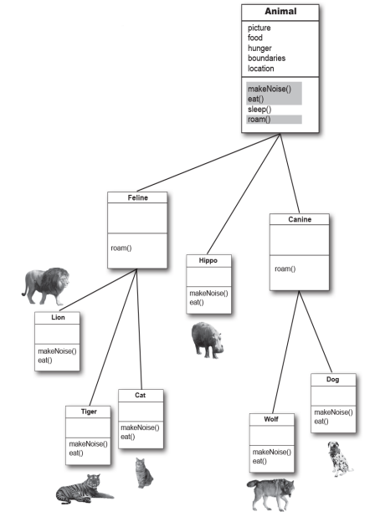

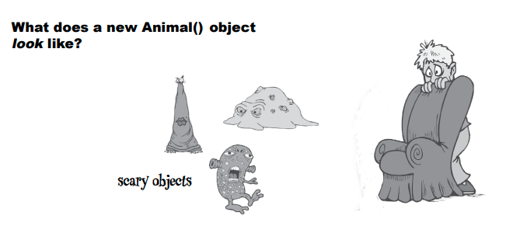
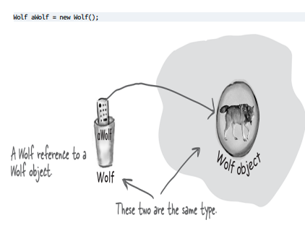
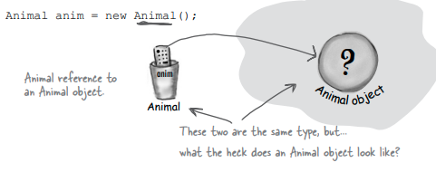
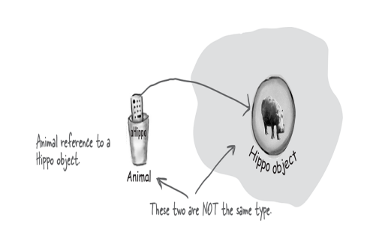
Notes:
Reiterate over object and reference Introduce the notion that an animal doesn’t mean something and we need to always be more precise on our code

Slide 3
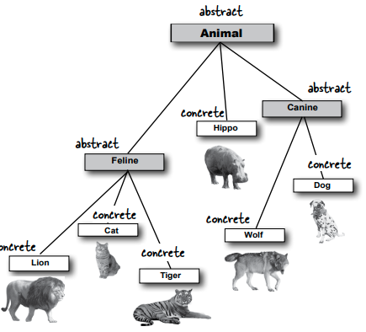
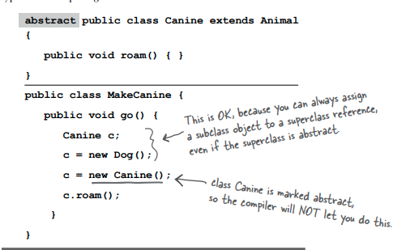
Notes:
How can we limit what an animal looks like Show how to use abstract, define it as a new keyword

Slide 4
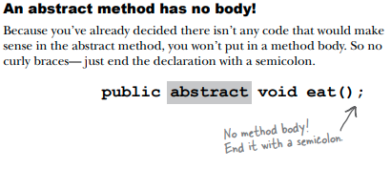
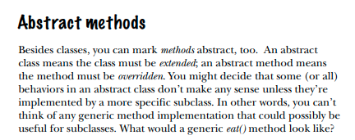
Notes:
Where we can use abstract
how it affects methods

Slide 5
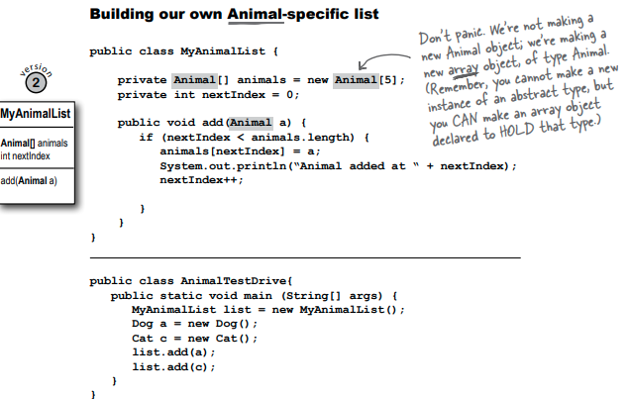

Slide 6
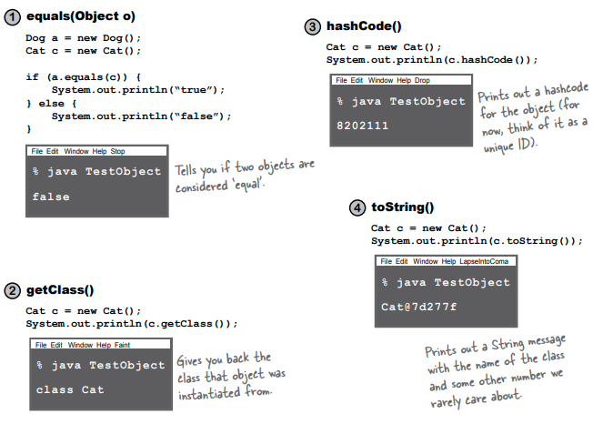
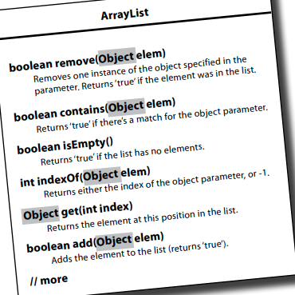
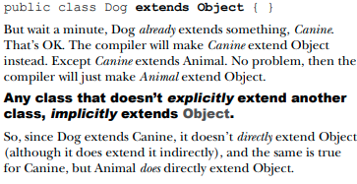
Notes:
We can use abstract types for other purposes, like making some methods more general
We keep saying that all classes are Objects, what this means is actually the all classes inherit Object Hence they have

Slide 7
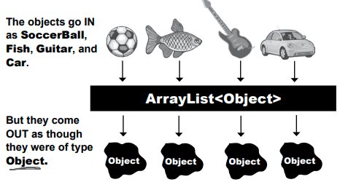
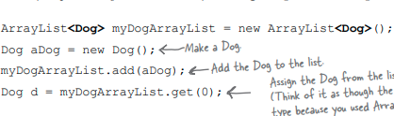

Notes:
We build a list of dogs and add a dog to it We build a list of objects and add a dog to it Will this line of code work with the array of objects ? Why is that ?

Slide 8
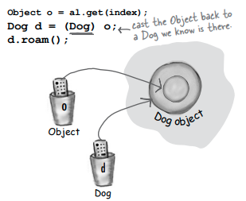
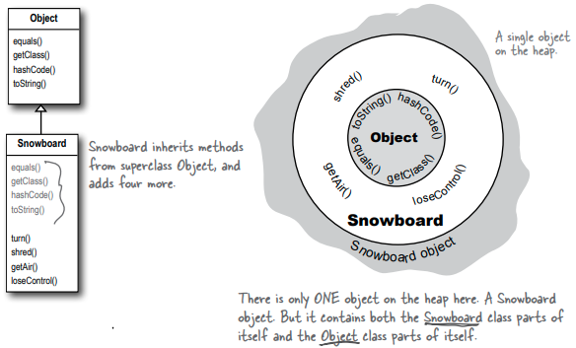
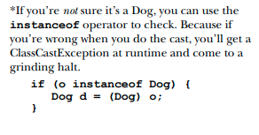
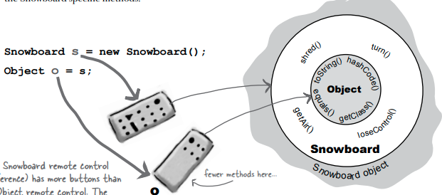
Notes:
Let’s say we build this object,
On the heap we will always have the snowboard object with snowboard and object class methods and fields

Slide 9
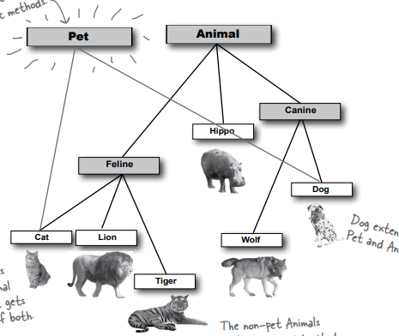
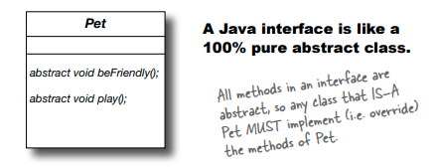
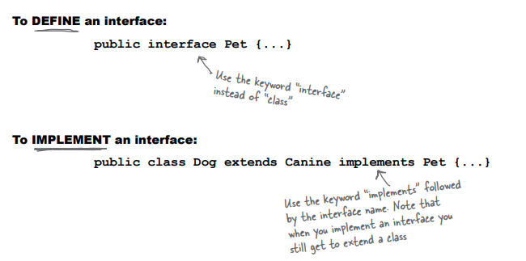
Let’s modelate a pet shop
Notes:
We need to select only a few of our classes to be usable as pet
Explain what an interface is
And how to use it

Slide 10
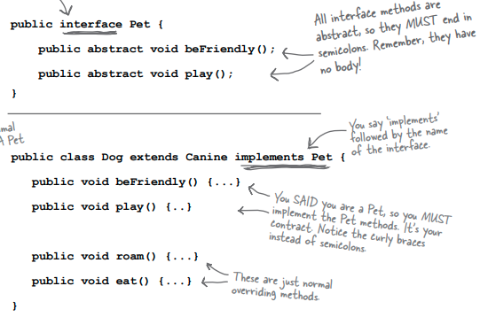
Notes:
Examples of how to use it

Slide 11
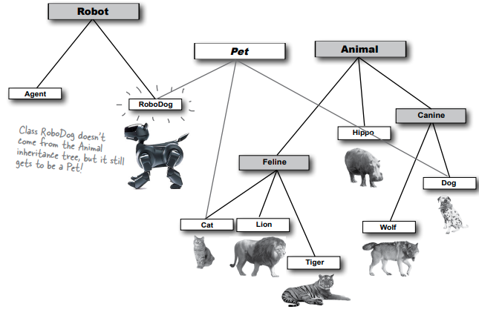
Notes:
Interfaces are helpful when we want to enforce behviour on certain classes

Slide 12
TODO
Update your animal kingdom mapping to have pets and robots

